Slide 1
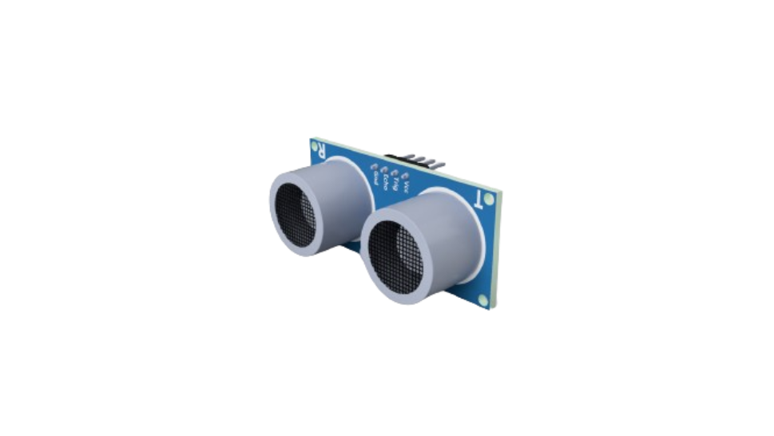

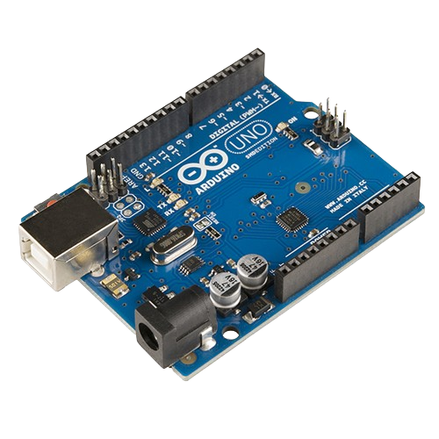
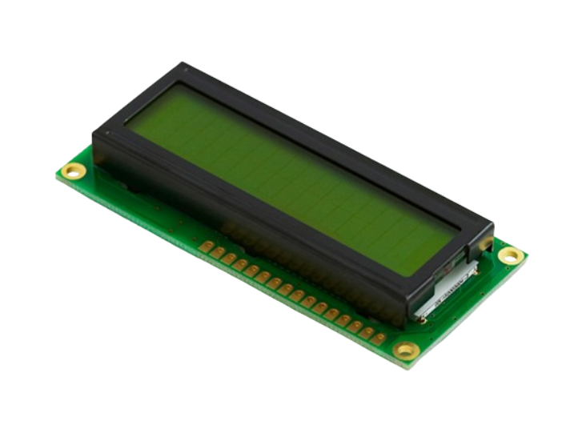

Arduino Course
Prepared by: Qossay Abu Rida

Slide 2
Agenda
Embedded system
ADC & DAC
Arduino environment
Sensors
Actuators
Communication

Slide 3
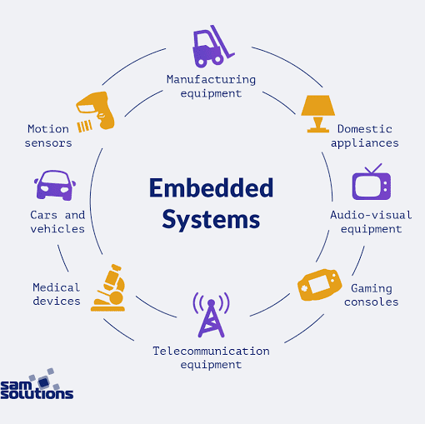
Embedded System

Slide 4
What is an Embedded System?
Definition: An embedded system is a specialized computer system that is designed to perform a specific task. Unlike general-purpose computers, which can run a variety of applications, embedded systems are dedicated to one or a few functions.
Common Use: Embedded systems are found in many everyday devices, from household appliances to automobiles, medical equipment, and industrial machines.

Slide 5
Basic Structure of an Embedded System
1- Microcontroller/Microprocessor:
The brain of the embedded system.
Executes programmed instructions to perform specific tasks.
Example: Arduino uses the ATmega328 microcontroller.
2- Memory:
RAM (Random Access Memory): Temporary storage for data and instructions currently in use.
ROM (Read-Only Memory): Permanent storage for the system's firmware and operating instructions.

Slide 6
3- Input Devices:
Collect data from the external environment.
Examples: Sensors, buttons, keyboards.
4- Output Devices:
Deliver data or actions to the external environment.
Examples: Displays, LEDs, motors.
5- Power Supply:
Provides the necessary power for the system to operate.
Can be battery-operated or connected to a power source.
6- Communication Interfaces:
Allow the system to communicate with other systems or devices.
Examples: Serial ports, USB, Wi-Fi, Bluetooth.

Slide 7
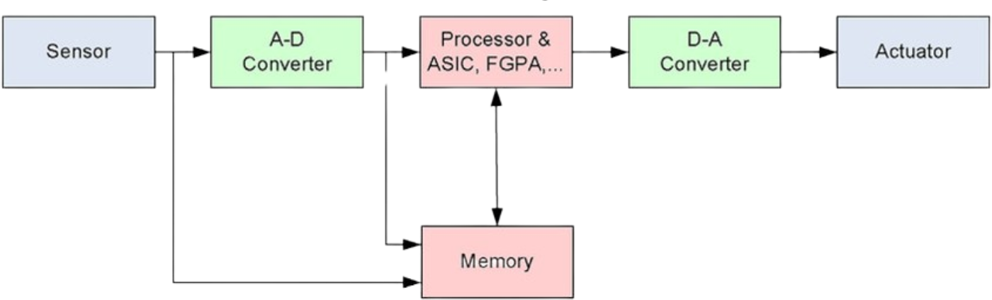
Basic Structure (Symbolic-Based)

Slide 8
Example of an Embedded System: Digital Thermometer
Microcontroller: Reads temperature data from the sensor and processes it.
Sensor: Measures the temperature and sends data to the microcontroller.
Display: Shows the temperature reading to the user.
Buttons: Allow users to switch between Celsius and Fahrenheit or reset the device.
Power Supply: Battery that powers the thermometer.

Slide 9
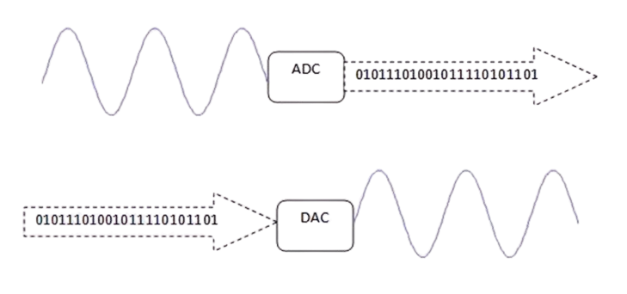
ADC & DAC

Slide 10
What is an ADC?
Definition: An Analog-to-Digital Converter (ADC) is a device that converts analog signals (continuous signals) into digital signals (discrete signals) that a microcontroller or computer can process.
Purpose: To allow digital systems to interact with the real world by converting analog inputs (e.g., temperature, sound, light) into a format they can understand and process.
What is a DAC?
Definition: A Digital-to-Analog Converter (DAC) is a device that converts digital signals (discrete signals) into analog signals (continuous signals).
Purpose: To allow digital systems to produce analog outputs (e.g., audio signals, light intensity control) that can be used in the real world.

Slide 11
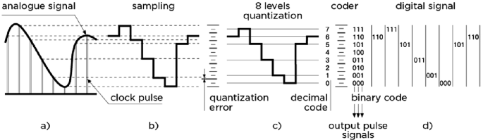
How ADC Works
Sampling: The analog signal is sampled at regular intervals.
Quantization: Each sample is approximated to the nearest value within a range.
Encoding: The quantized values are converted into binary code.

Slide 12
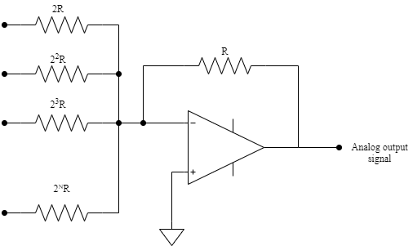
How DAC Works
Input: The digital signal is received from a microcontroller or computer.
Conversion: The digital values are converted to corresponding analog values.
Output: The analog signal is output to drive an analog device.

Slide 13
Arduino Environment

Slide 14
Arduino Hardware
Arduino Boards
Microcontroller-based boards with various input/output capabilities.
Examples: Arduino Uno, Arduino Mega, Arduino Nano.
Key Components
Microcontroller: The brain of the board (e.g., ATmega328 on Arduino Uno).
Digital Pins: Used for digital input/output (e.g., LEDs, buttons).
Analog Pins: Used for analog input (e.g., sensors).
Power Supply: Can be powered via USB or external power source.
Communication Ports: Serial, I2C, SPI for interfacing with other devices.

Slide 15
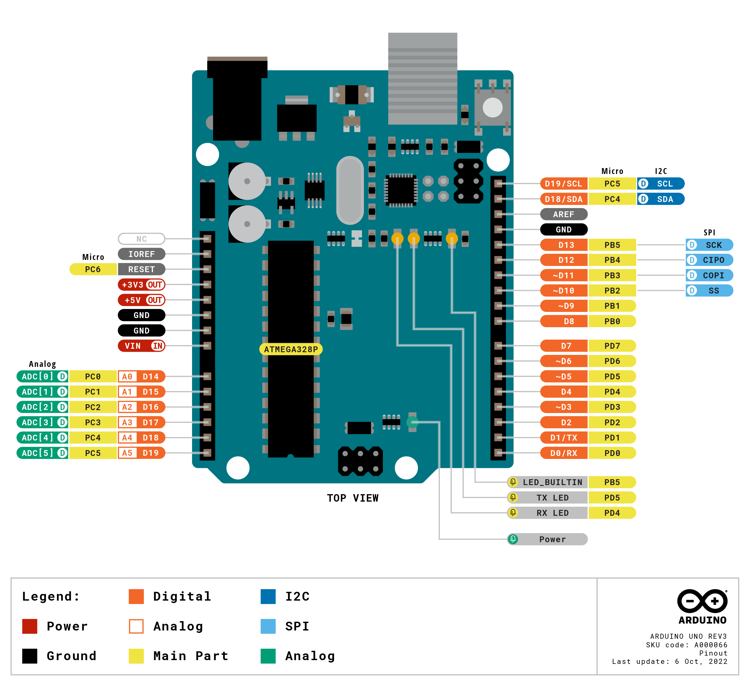
Arduino Uno board with labeled components.

Slide 16
Arduino Software (Arduino IDE)
Arduino IDE
Integrated Development Environment for writing, compiling, and uploading code to Arduino boards.
Available for Windows, Mac, and Linux.
Key Features
Code Editor: Write and edit Arduino sketches (programs).
Compiler: Convert sketches into machine code that the microcontroller can execute.
Uploader: Transfer the compiled code to the Arduino board via USB.
Serial Monitor: Communicate with the board and debug sketches using serial communication.
Programming Language
Based on C/C++ with simplified syntax and functions.
Uses libraries to add functionality (e.g., controlling motors, reading sensors).

Slide 17
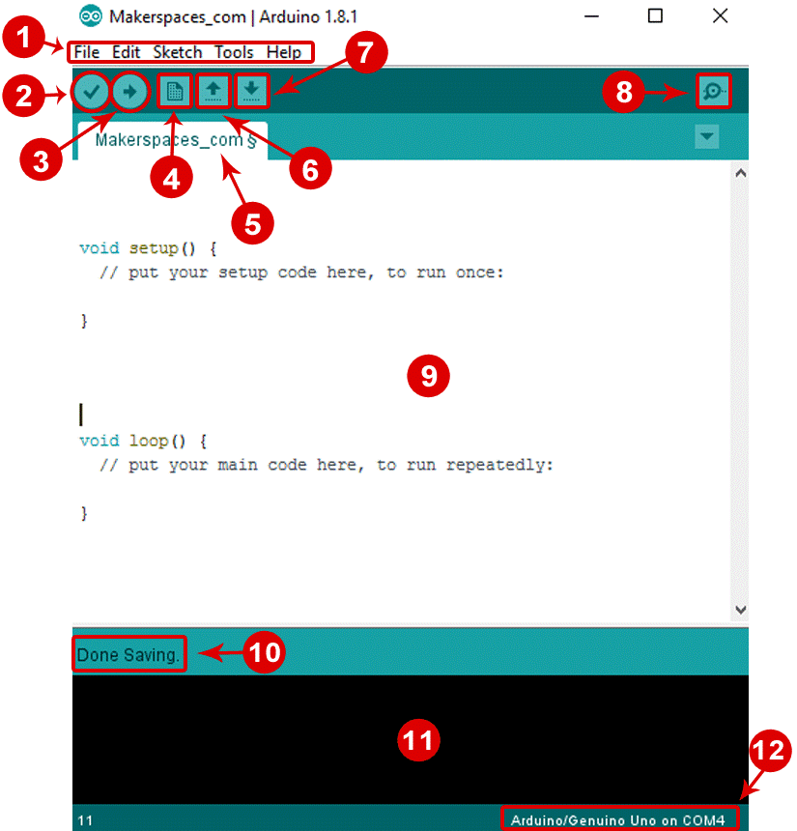
Arduino IDE simple sketch.

Slide 18
Speaking impact
Your ability to communicate effectively will leave a lasting impact on your audience
Effectively communicating involves not only delivering a message but also resonating with the experiences, values, and emotions of those listening

Slide 19
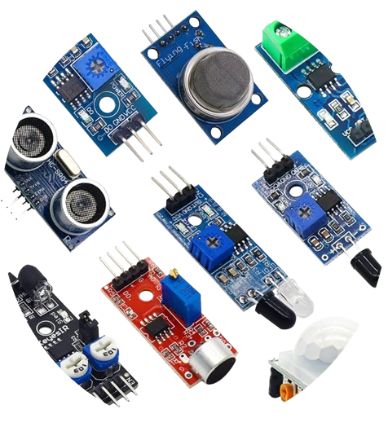
Sensors

Slide 20
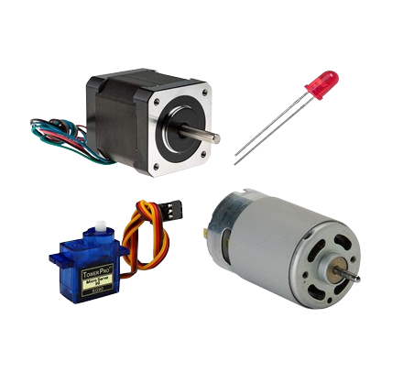
Actuators

Slide 21
Basic Electronic Component

Slide 22
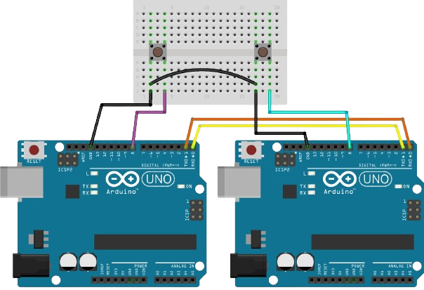
Communication

Slide 23
Final tips & takeaways
Seek feedback
Reflect on performance
Explore new techniques
Set personal goals
Iterate and adapt
Consistent rehearsal
Strengthen your familiarity
Refine delivery style
Pacing, tone, and emphasis
Timing and transitions
Aim for seamless, professional delivery
Practice audience
Enlist colleagues to listen & provide feedback

Slide 24
Speaking engagement metrics

Slide 25




Contact us

